Slide 1

CMR Technical Campus Department of IT
Major Project Stage – II
Review - I
PROJECT TITLE : HYBRID AUTOENCODER DRIVEN ML MODEL FOR PERFORMANCE MONITORING IN 5G CELLULAR NETWORKS
Project Supervisor:​
Name:​Ravi Regulagadda
Designation: Assistant Professor
Presented By:
Batch : 9
1. H. No : 227R1A1257 Name : V. Poojitha
2. H. No : 227R1A1223 Name : J. Vamshi
3. H. No : 227R1A1215 Name : E. Greeshma
​

Slide 2
INTRODUCTION AND OVERVIEW
The advent of fifth generation (5G) cellular networks marks a revolutionary leap in communication technology, promising ultra-low latency, enhanced bandwidth, and massive device connectivity.
With the exponential growth of mobile applications, IoT devices, and high-throughput services such as autonomous driving and augmented reality, 5G is positioned as the backbone of future digital ecosystems.
Historically, mobile networks have evolved from 1G analog voice systems through 4G LTE, each generation improving speed and efficiency but still facing critical challenges in spectrum utilization, energy efficiency, and dynamic resource management.
Despite these advances, traditional cellular systems struggle to meet the stringent requirements of real-time applications in terms of reliability, security, and scalability.
Conventional systems rely on static resource allocation, rule-based scheduling, and limited traffic prediction models.

Slide 3
EXISTING SYSTEM
Traditional 5G network monitoring is manual, labor-intensive, and largely reactive.
Engineers manually collect and analyze KPIs like signal strength, throughput, and latency.
Troubleshooting requires scanning large logs and traces across multiple systems.
Root cause analysis depends on expert knowledge and is time-consuming.
Issues are resolved after user impact, making the process slow and inefficient.

Slide 4
EXISTING SYSTEM DISADVANTAGES
Human Error and Bias
Time-Consuming and Slow
Reactive, Not Proactive
Lack of Scalability
Difficulty with Complex Patterns

Slide 5
PROPOSED SYSTEM
The system automates 5G network performance monitoring to overcome manual and reactive limitations.
It uses a hybrid ML model called DeepLatent-Forest with a two-phase architecture.
A deep autoencoder extracts compressed, noise-free latent features from high-dimensional network data.
A Random Forest classifier uses these latent features to accurately predict dropped connections.
Integrated with a Tkinter GUI, the system enables real-time, proactive, and user-friendly network monitoring.

Slide 6
PROPOSED SYSTEM ADVANTAGES
Proactive Problem Prediction
Enhanced Accuracy
Automated Feature Engineering
Dimensionality Reduction
Robustness to Noise

Slide 7
SYSTEM REQUIREMENTS
SOFTWARE COMPONENTS | HARDWARE COMPONENTS
Python version : Python 3.12.0 | Processor : Intel i5
Operating system : Windows | Memory : 1 TB (storage)
Frontend : Tkinter | RAM : 8 GB

Slide 8
NOVELITY
Proposes a hybrid DeepLatent-Forest model combining a deep autoencoder with Random Forest for 5G performance monitoring.
Uses unsupervised deep autoencoder–based feature extraction to handle high-dimensional and noisy 5G network data.
Enables proactive prediction of dropped connections instead of reactive fault detection.
Achieves higher accuracy and robustness compared to traditional ML classifiers like KNN, XGBoost, and CatBoost.
Integrates the model into a GUI-based, role-secured system, making advanced ML accessible for real-world network operations.

Slide 9
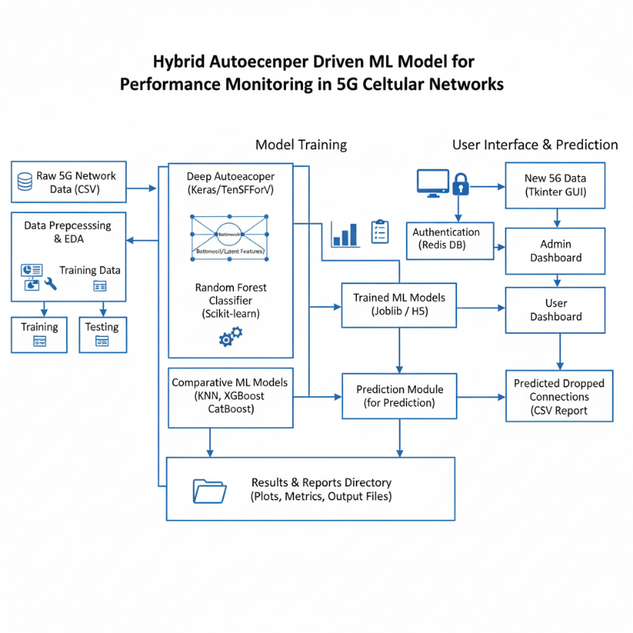
SYSTEM ARCHITECTURE

Slide 10
MODULES
Dataset Collection Module
Collects 5G network performance data such as signal strength and speed.
Stores data for preprocessing and model training.
Data Preprocessing Module
Cleans data, removes irrelevant columns, and handles missing values.
Encodes categorical features and applies feature scaling.
Exploratory Data Analysis Module
Analyzes data patterns related to dropped connections.
Visualizes correlations and class distributions.
Baseline Machine Learning Module
Trains KNN, CatBoost, and XGBoost models.
Provides baseline performance for comparison.

Slide 11
MODULES
Autoencoder Feature Extraction Module
Learns compact latent features from high-dimensional data.
Reduces noise and redundancy in network parameters.
Hybrid Deep Latent Forest Module
Combines autoencoder features with Random Forest classifier.
Improves accuracy in dropped connection prediction.
Model Evaluation Module
Calculates accuracy, precision, recall, and F1-score.
Generates confusion matrices for analysis.
Prediction Module
Predicts dropped connections for new 5G data.
Appends prediction results to the dataset.

Slide 12
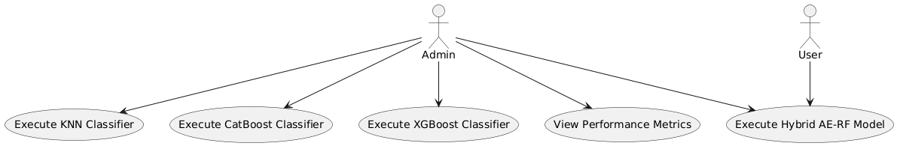
USE CASE DIAGRAM

Slide 13
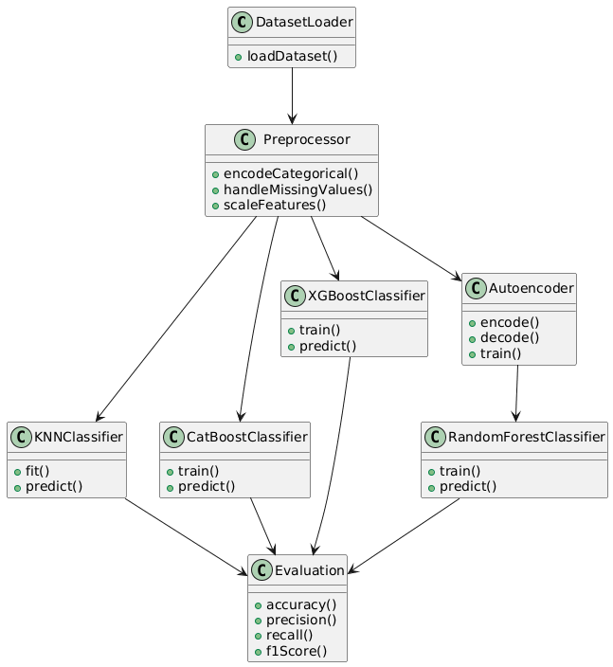
CLASS DIAGRAM

Slide 14
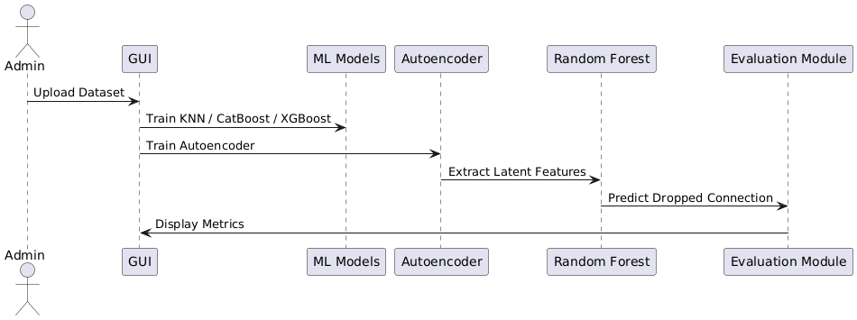
SEQUENCE DIAGRAM

Slide 15
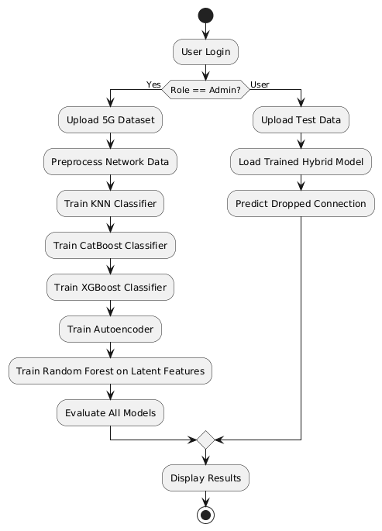
ACTIVITY DIAGRAM

Slide 16


